Slide 1


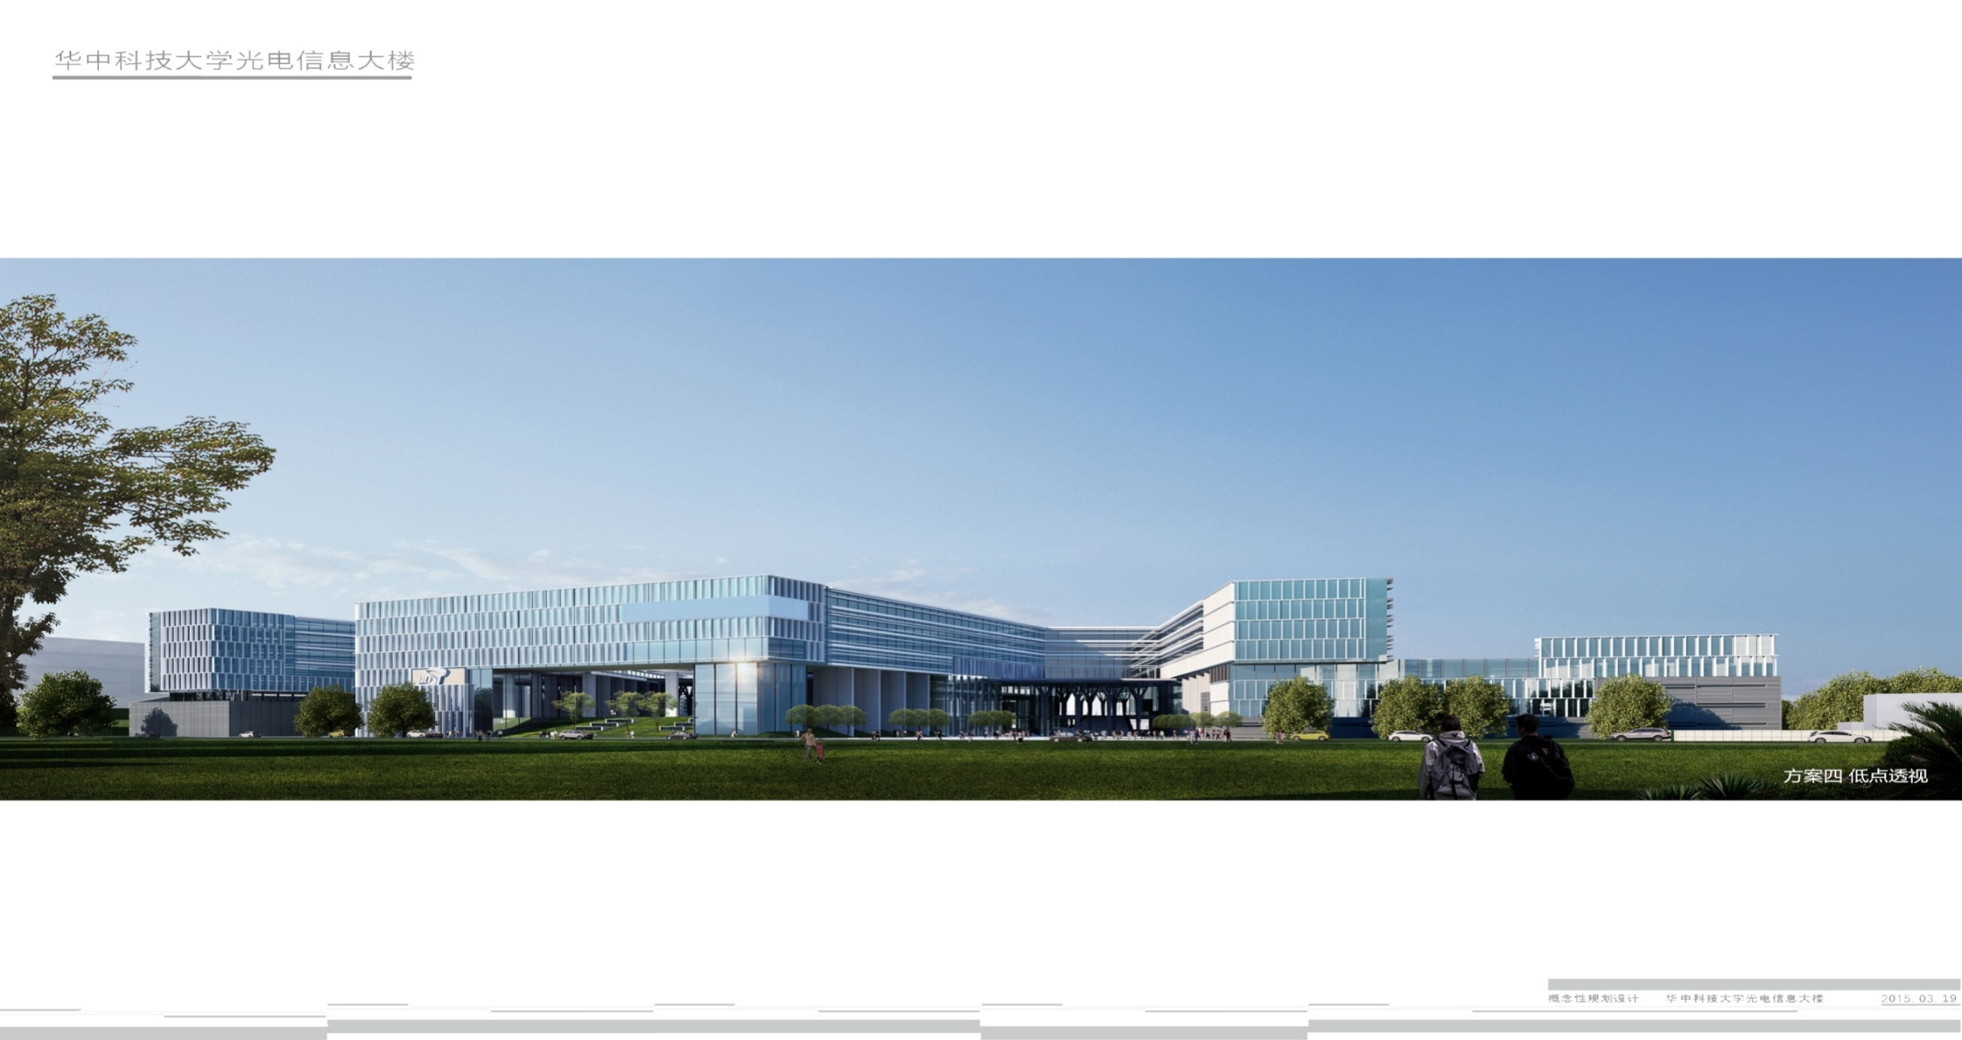
Weekly Report
Speaker :Ying Jie

Slide 2

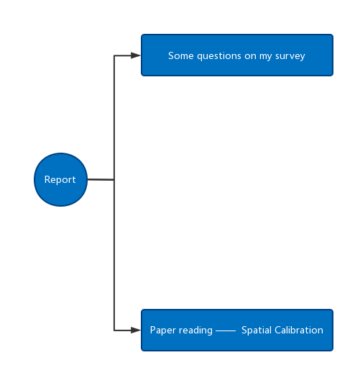
Report Content

Slide 3
Part 1: Introduction of Cameras

Slide 4
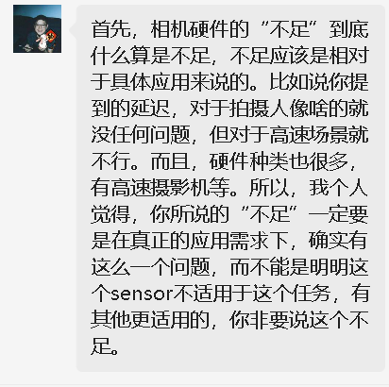
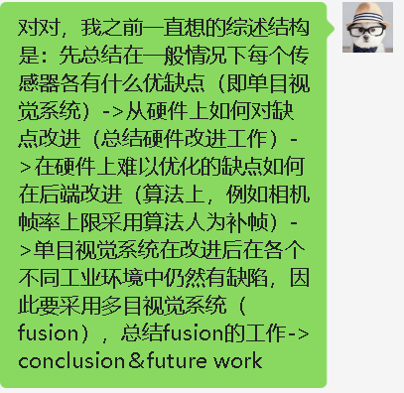
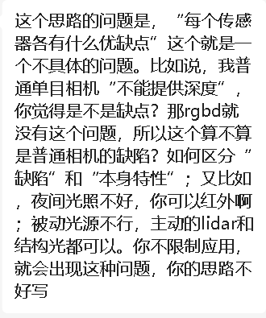
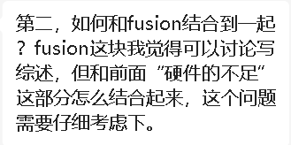
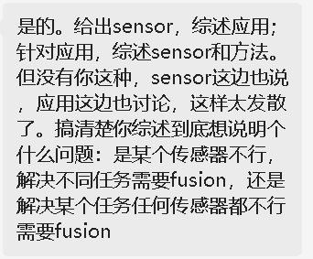
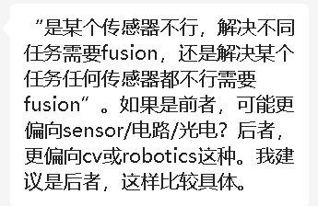
Some discussions with senior

Slide 5
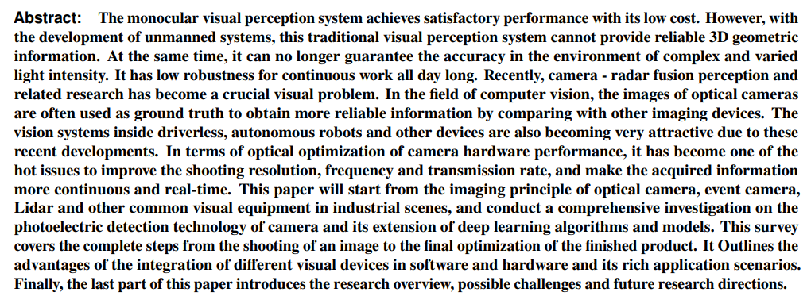
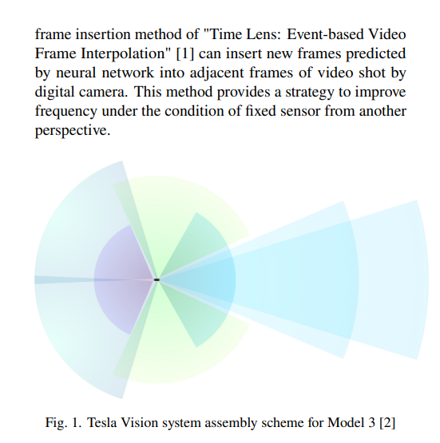
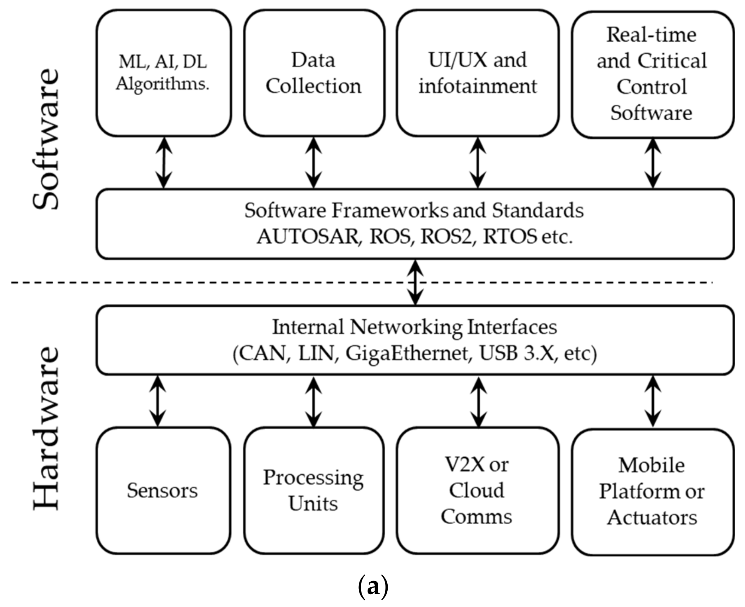
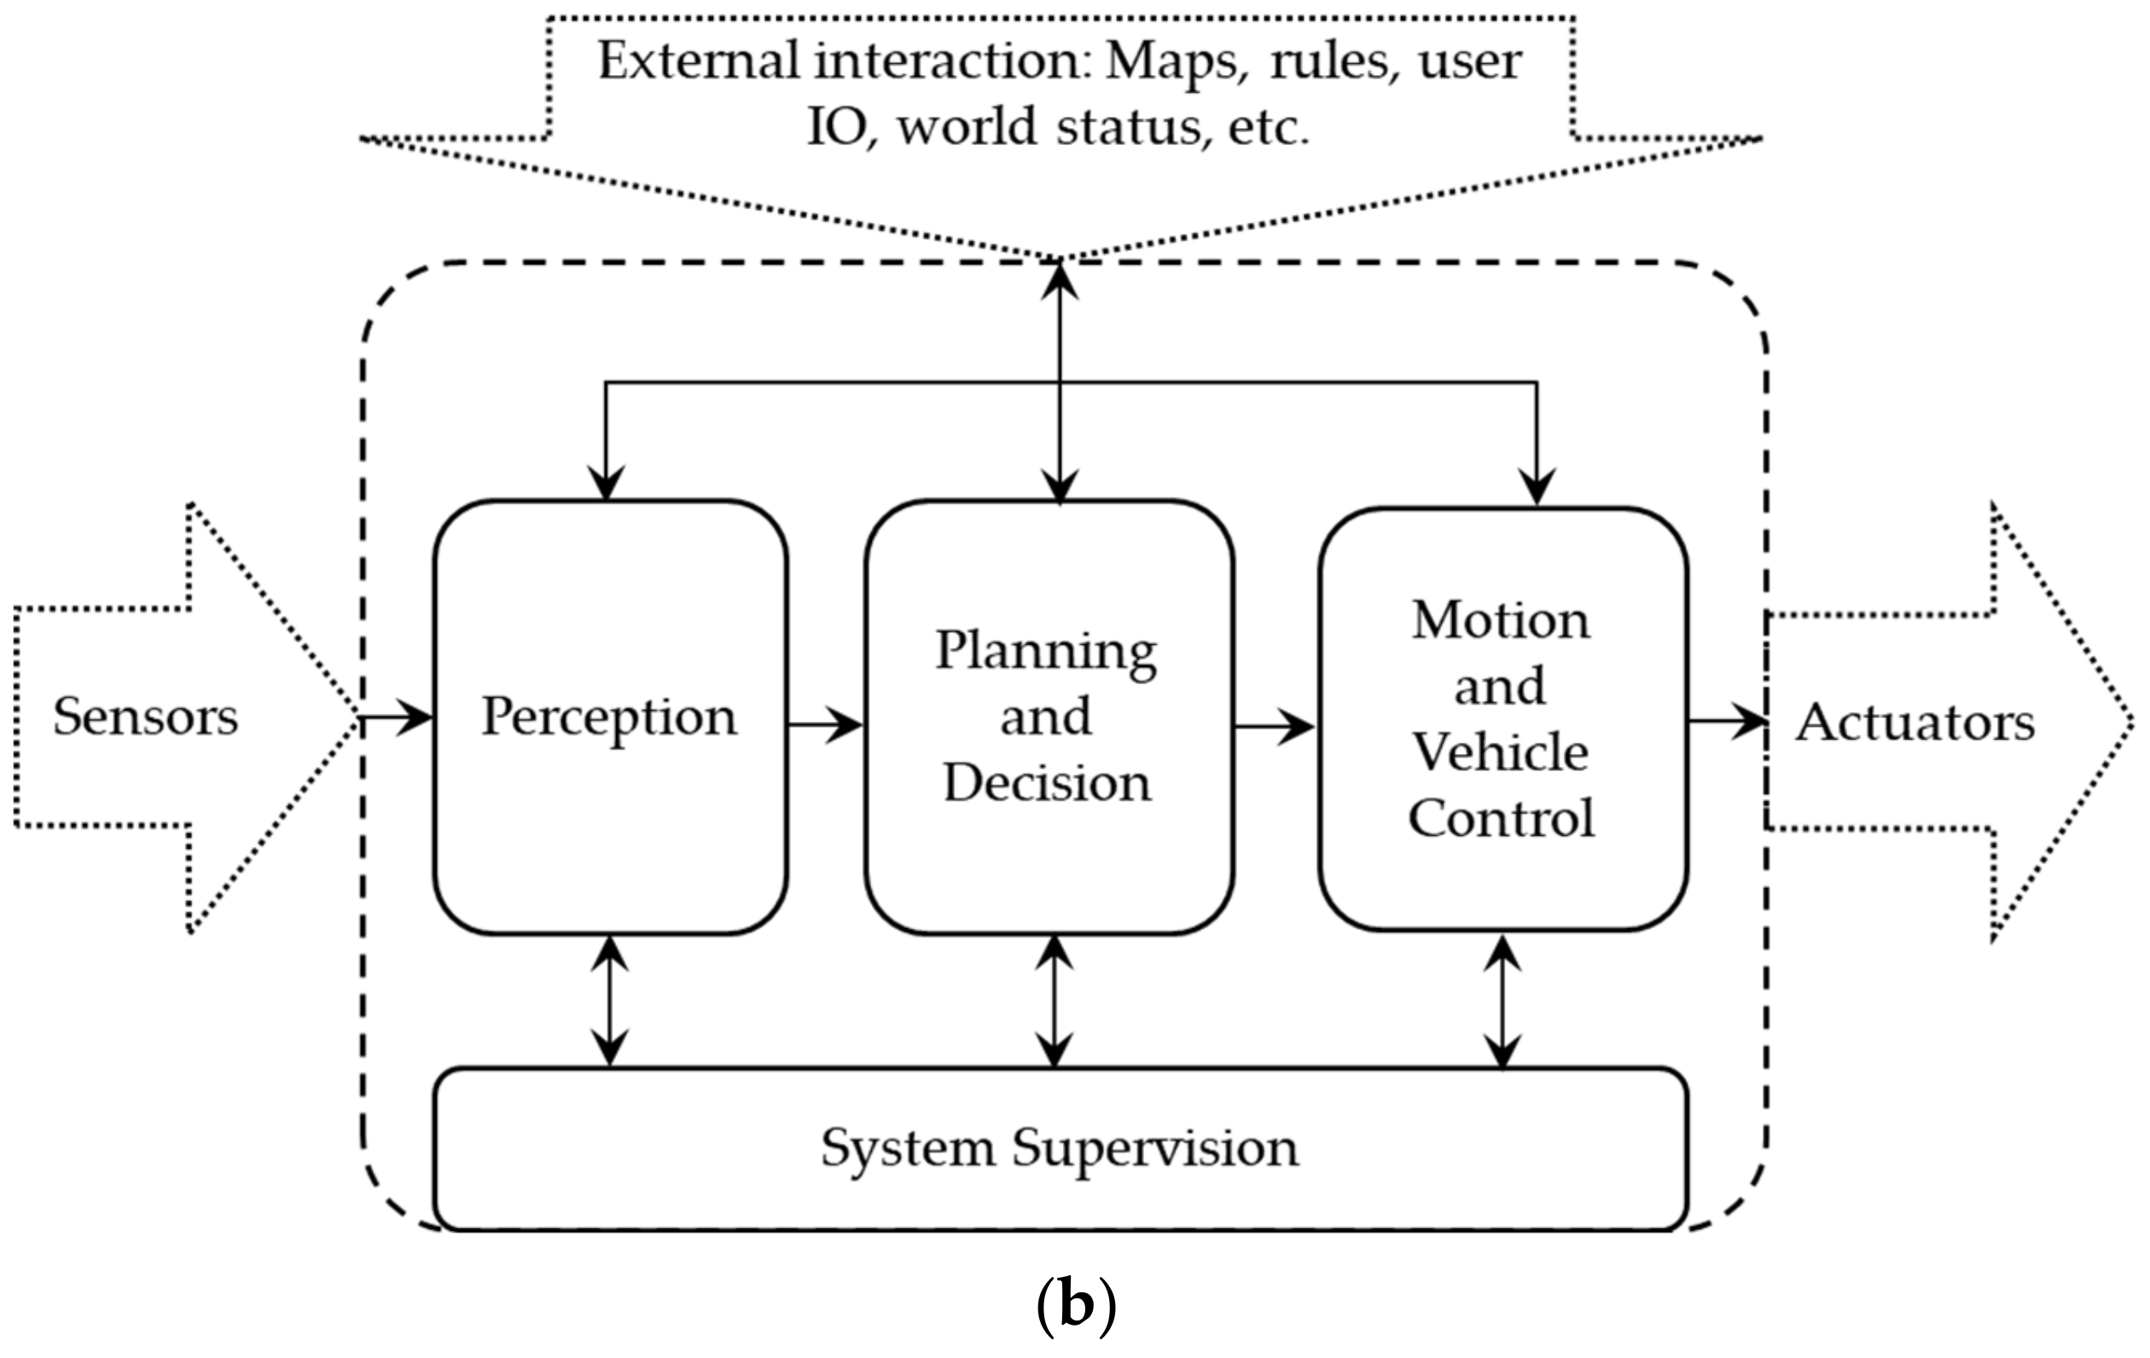
Sensor fusion for autonomous driving:a comprehensive review from hardware to deep learning
Abstract:
The significance of unmanned driving today and the development status of this field are discussed
Introduction:
Describes the principles and hardware parameters of each sensor and describes fusion

Slide 6
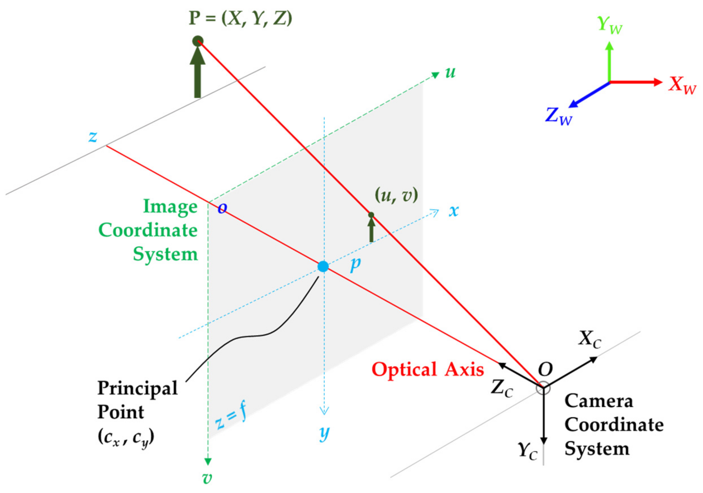
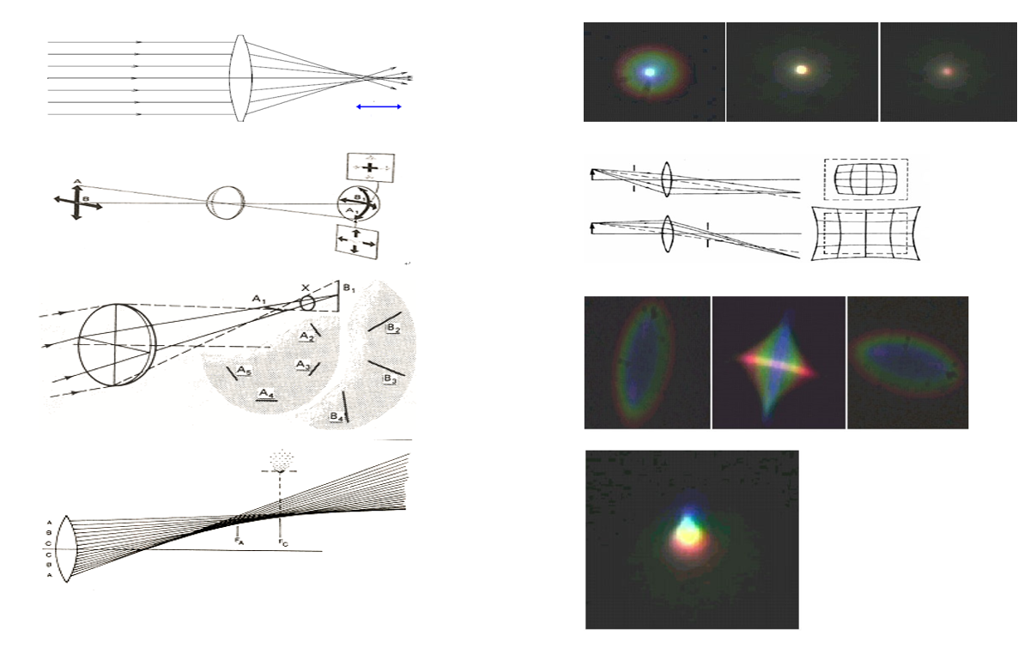
Sensor fusion for autonomous driving:a comprehensive review from hardware to deep learning
Sensor:
Difference & calibration within the discussion of real situation

Slide 7
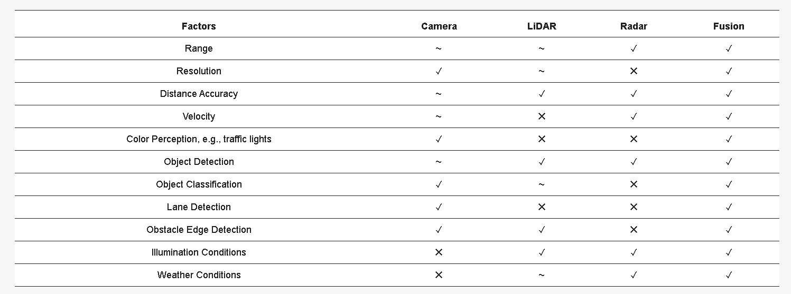
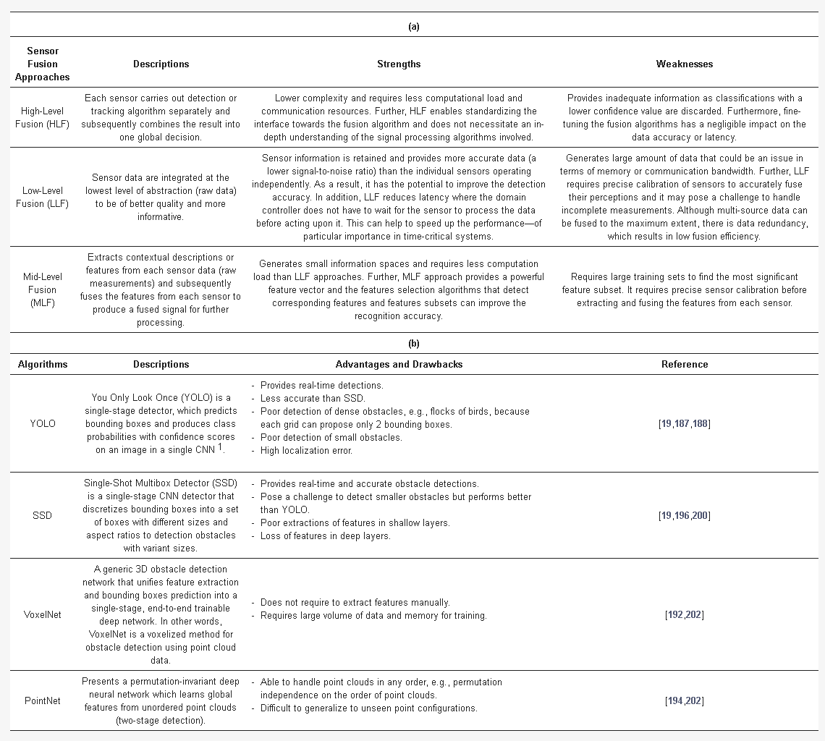
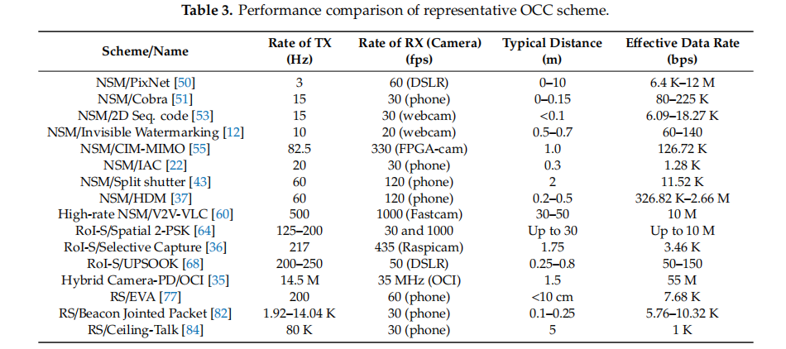
Sensor fusion for autonomous driving:a comprehensive review from hardware to deep learning
Sensor Fusion:
Fusion was proposed to solve some of the visual problems
Algorithmic solution
Sensor solution & chosen for fusion

Slide 8
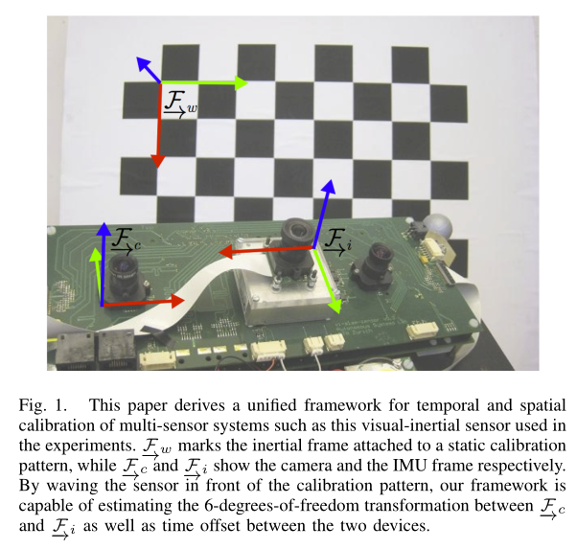

Unified Temporal and Spatial Calibration for Multi-Sensor Systems
# Paper Abstract：
1. Provenance： IEEE/RSJ 2013
2. Author：
3. Citation：624
Abstract:
A new framework is proposed for the joint estimation of the time offset between different sensor measurements and their spatial displacement with respect to each other.
The framework is capable of accurately estimating time offset, even a fraction of the smallest measurement period.

Slide 9

Unified Temporal and Spatial Calibration for Multi-Sensor Systems

Slide 10

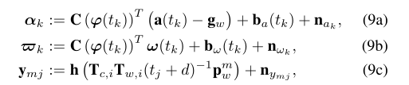

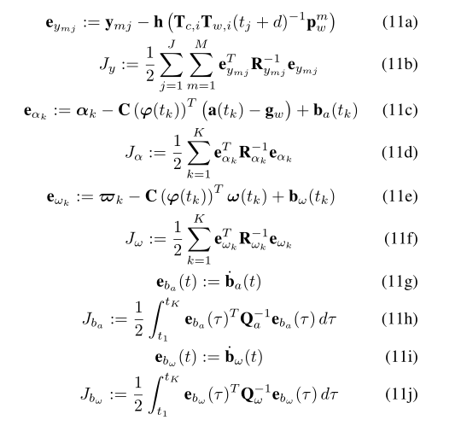

Unified Temporal and Spatial Calibration for Multi-Sensor Systems

Slide 11
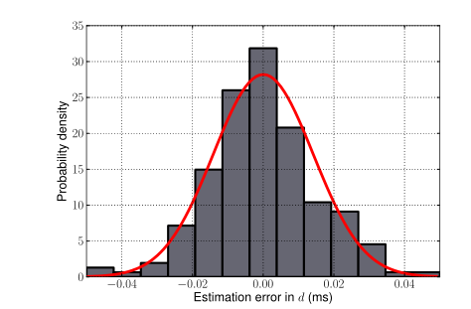
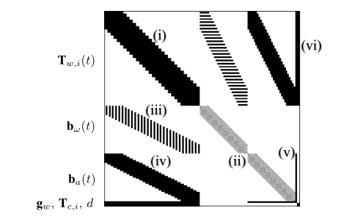
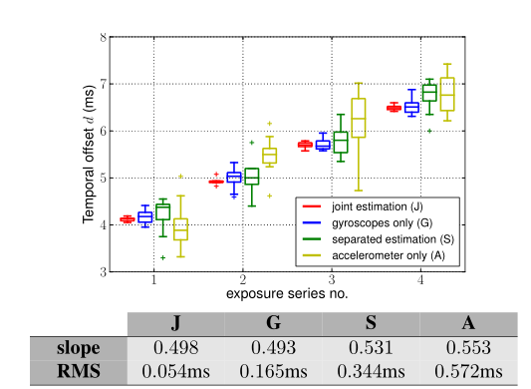
Cameras and Image Categories

Slide 12
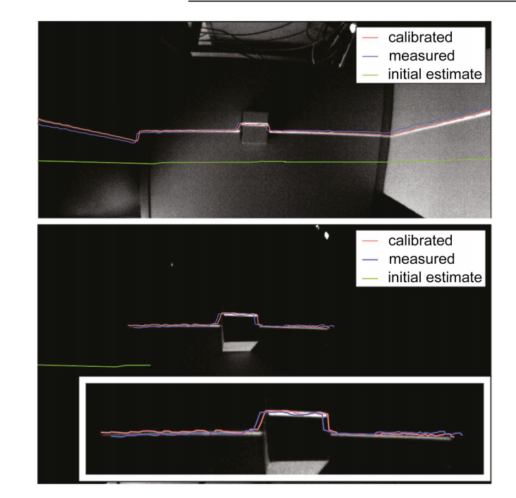
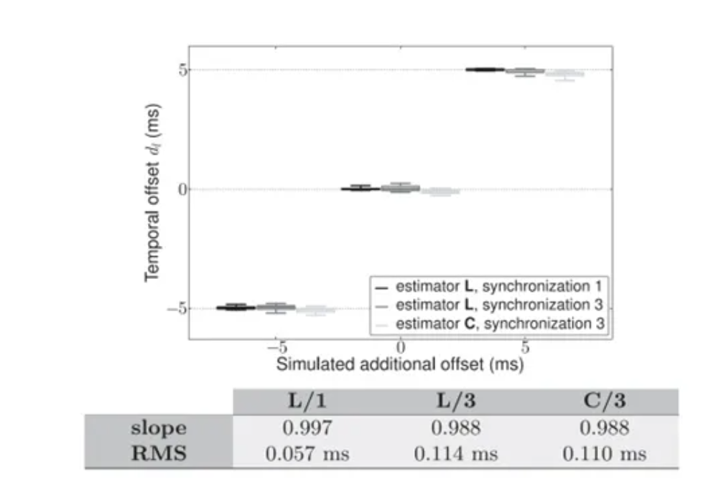
Unified Temporal and Spatial Calibration for Multi-Sensor Systems
# Paper Abstract：
1. Provenance： IEEE 2016
2. Author：
3. Citation：68
Abstract:
A general and principled method for joint estimation of fixed time migration and space transformation between sensors is presented.
This method also uses the basis function to estimate time migration and the latest progress of continuous time batch estimation. It exists in the strict theoretical framework of maximum likelihood estimation and has higher repeatability and accuracy.

